Slide 1
Implementation of Median Filter on Z -Board and AWS
Reconfigurable Computing – Project.
By,
Anushka Swarup,
Medini J. Aradhya
Liming Xu

Slide 2
Project Description :
The Median Filter is a nonlinear digital filtering technique for removal of noise from images.
It works particularly well for certain types of random noises like the salt and pepper noise.
This method is often used as a preprocessing step for edge detection algorithms. It is advantageous as this method better preserves the edges in certain instances.
The amazon web services cloud platform is compatible with existing FPGA algorithms hence makes it a versatile open source platform for accelerated computing.
Notes:
medini

Slide 3
Software Algorithm – MATLAB
Medfilt2() – 2D Median Filtering
J = medfilt2(I)
performs median filtering of the image I in two dimensions.
Each output pixel contains the median value in a 3-by-3 neighborhood in the input image.
Notes:
anushka

Slide 4
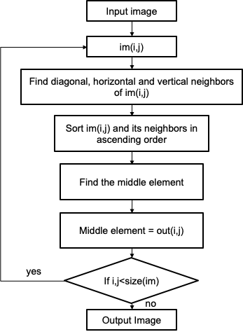
Software Algorithm – C++
■Input image of size 128x128 was used
■A 3x3 window was obtained at each pixel
■Selection sort algorithm was used to arrange the window in ascending order
■Border pixels are not considered, hence the output image is of size 126x126
Notes:
anushka

Slide 5
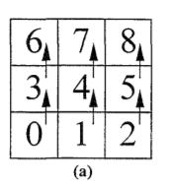
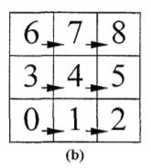
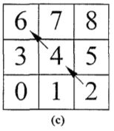
Hardware Algorithm
Sort the pixels vertically with triple sorters
Sort the pixels horizontally
Sort accross the diagonal in the middle
The center of the square is the median
Vertical Sort
Horizontal Sort
Diagonal Sort
Notes:
Liming

Slide 6
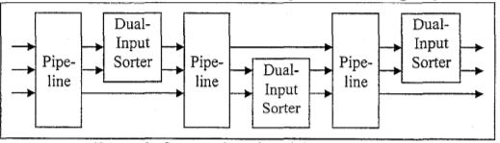
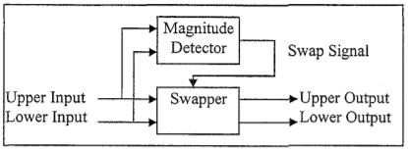
Hardware Algorithm
Notes:
Liming

Slide 7
Datapath Details :
First stage: 3*triple sorter in parallel, sort vertically
Second stage: 3*triple sorter in parallel, sort horizontally
Third stage: 1*triple sorter to sort diagonally
Latency: 3 stages*3 cycles per stage = 9 cycles
Notes:
Liming

Slide 8
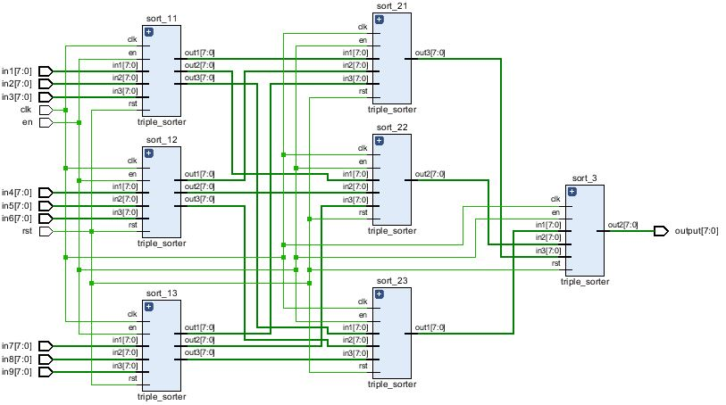
Design and Implementation
Datapath:
Notes:
Liming

Slide 9
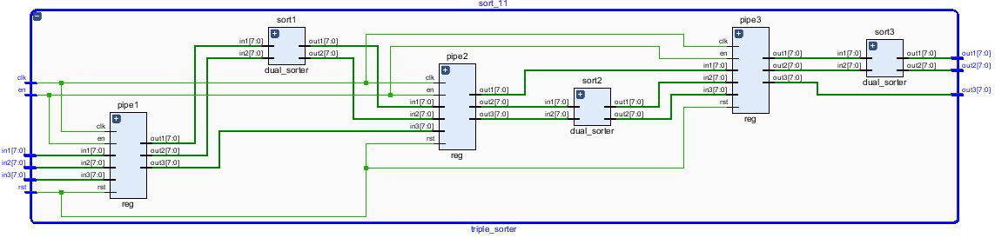
Design and Implementation
Datapath:

Slide 10
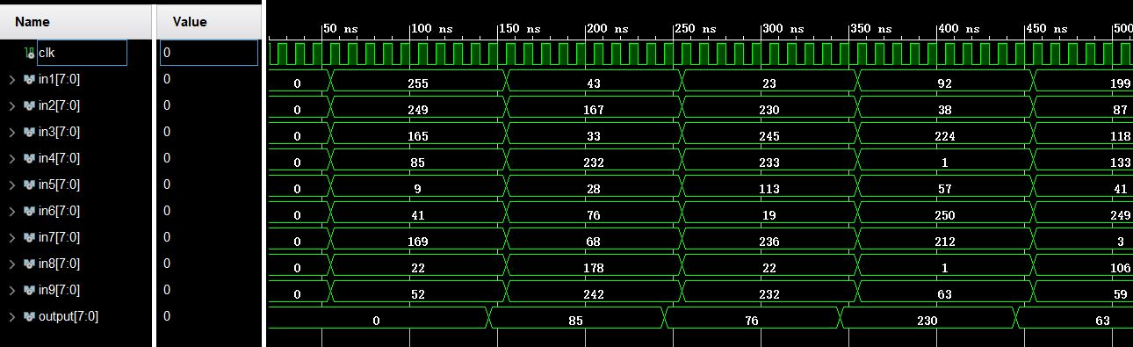
Design and Implementation
Datapath:
Latency: 3*3=9 cycles
Notes:
Liming

Slide 11
Design and Implementation - AWS
■ Xilinx FPGAs are available in the Amazon Elastic Compute Cloud (Amazon EC2) F1 instances.
■With F1 instances you can:
→ deploy custom hardware acceleration
→ Use your existing FPGA algorithms
Tool Used with AWS-F1 is SDAccel.
Notes:
Medini

Slide 12
Design and Implementation - AWS
Structure:
Create F1 Instance on AWS.
Create Storage bucket and Private connection keys.
Launch EC2-F1 Instance
Connect to it via PuTTy with the connection keys.
Set up GUI on the instance ( Since AWS FPGA Developer AMI does not include GUI )
→ Hence connect to the RDP Client where the instance is running Centos 7 and the FPGA Developer AMI.
Configure the instance for working with SDAccel ( By create groups> users> add permissions > get authentication details >
Notes:
Medini

Slide 13
Design and Implementation - AWS
6) Configure the SDAccel Environment :
→ Execute the following commands from the command line of the instance terminal:
git clone https://github.com/aws/aws-fpga.git $AWS_FPGA_REPO_DIR
cd $AWS_FPGA_REPO_DIR
source sdaccel_setup.sh → First time you run it, the script will download the platform and compile the runtime and drivers. Subsequent runs are much faster. You must source sdaccel_setup.sh each time you open a new terminal.
Notes:
Medini

Slide 14
Block Diagram
ADDRESS
GENERATOR
B
R
A
M
1
B
R
A
M
2
B
R
A
M
3
MEMORY MAP
CONTROLLER
SMART BUFFER 1
SMART BUFFER 2
SMART BUFFER 3
GLUE LOGIC
DATAPATH
ADDRESS
GENERATOR
BRAM 4
Notes:
Medini

Slide 15
Testing & Demonstration – Software
A set of popular test images were used to compare the results of the MATLAB function and the C++ code
In the final presentation, results from the MATLAB function will be used for visual comparison with the hardware results
Whereas, results from the C++ code will be used to compare the speedup with the hardware implementation
Notes:
Anushka

Slide 16
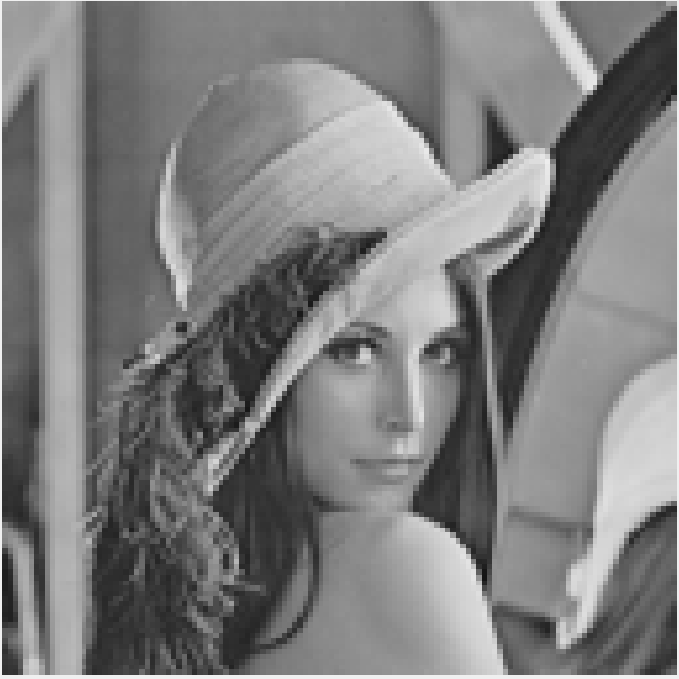

Results – MATLAB
Original Image (128X128)
Output Image - medfilt2() (128X128)
Notes:
Anushka

Slide 17
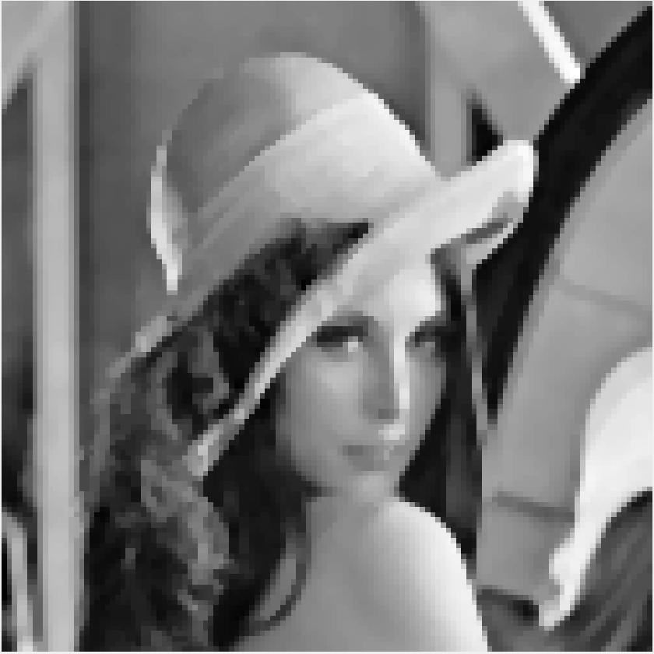
Results – C++
Original Image (128X128)
Output Image - C++ (126X126)
Notes:
Anushka

Slide 18
Salt & Pepper Noise
The median filter is said to be most efficient in removing salt & pepper noise from images
So we created noisy images by adding salt & pepper noise to original images using MATLAB
Notes:
Anushka

Slide 19
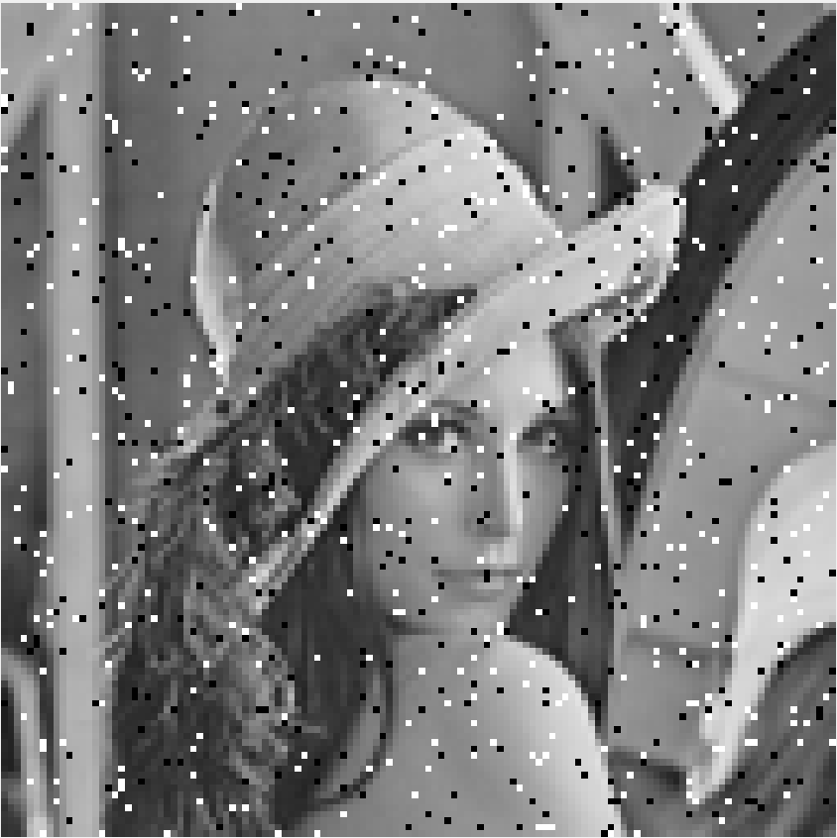

Results – MATLAB
Input Image – Salt & Pepper Noise (128X128)
Output Image - medfilt2() (128X128)
Notes:
Anushka

Slide 20
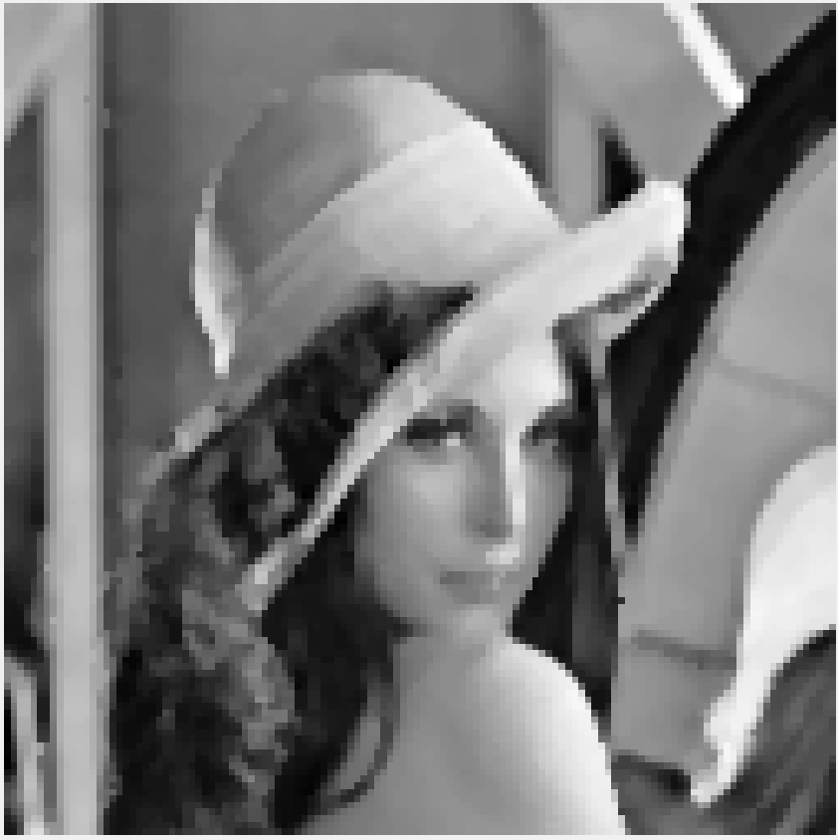
Results – C++
Input Image – Salt & Pepper Noise (128X128)
Output Image - C++ (126X126)
Notes:
Anushka

Slide 21
MATLAB Output
C++ Output
Without Noise
With Noise

Slide 22


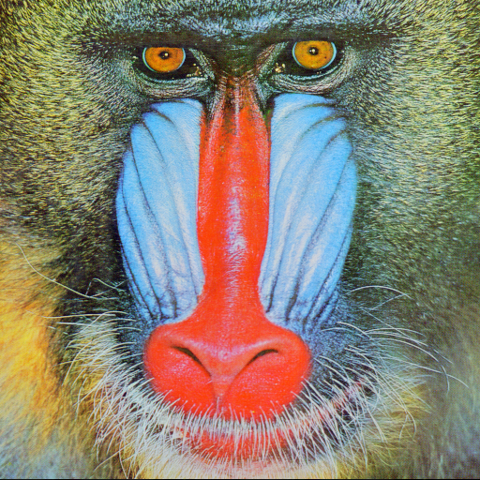
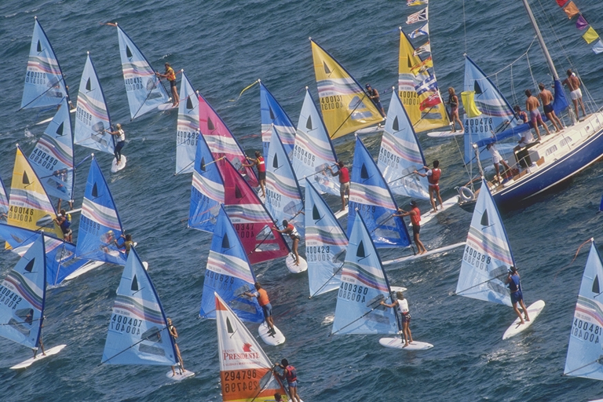
Dataset Used
Notes:
Anushka

Slide 23
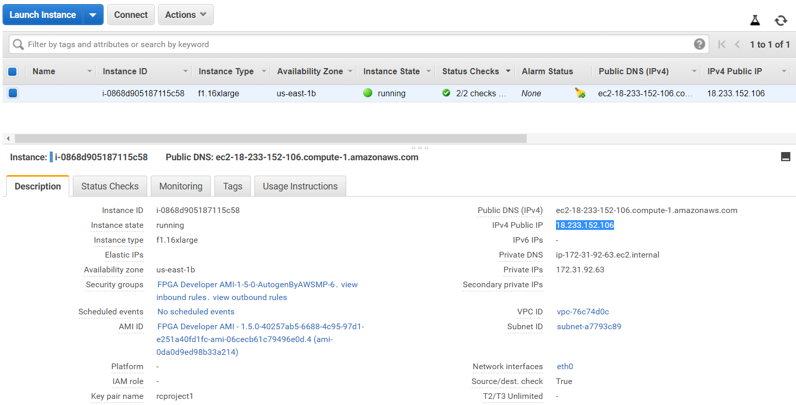
Testing & Demonstration – AWS
Notes:
Medini

Slide 24
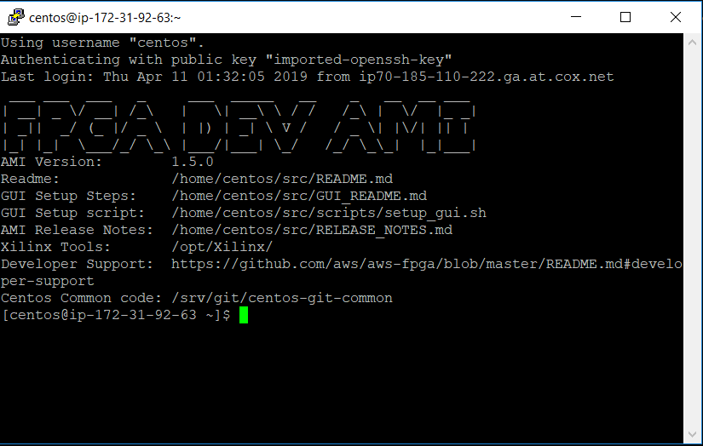
Testing & Demonstration – AWS
Notes:
Medini

Slide 25
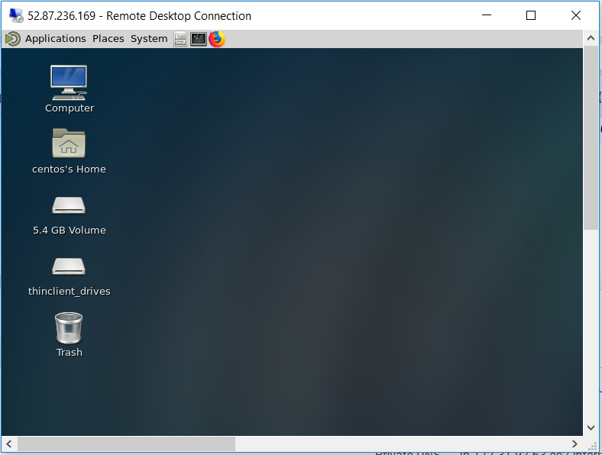
Testing & Demonstration – AWS
Connected to the RDP Client where the instance is running Centos 7 and the FPGA Developer AMI.
Notes:
Medini

Slide 26
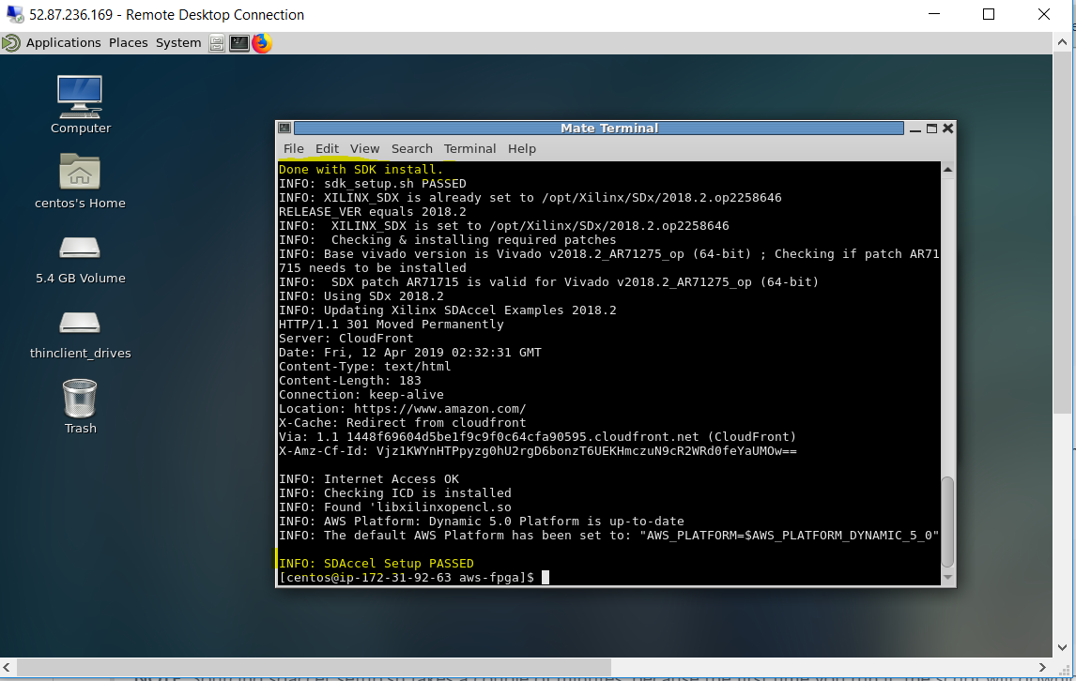
Testing & Demonstration – AWS
Notes:
Medini

Slide 27
Future Work
Hardware Implementation, debugging & Testing
AWS implementation of Median Filter
Timing speedup comparison between software(C++) and hardware (FPGA) implementation.
Comparison of Images obtained from software (MATLAB) and Hardware (FPGA) implementations.
Analysis of results.
Report writing & Presentation
Notes:
Medini

